Slide 1
18-447 Computer Architecture Lecture 19: High-Performance Caches
Prof. Onur Mutlu
Carnegie Mellon University
Spring 2015, 3/2/2015

Slide 2
Assignment and Exam Reminders
Lab 4: Due March 6 (this Friday!)
Control flow and branch prediction
Lab 5: Due March 22
Data cache
HW 4: March 18
Exam: March 20
Advice: Finish the labs early
You have almost a month for Lab 5
Advice: Manage your time well

Slide 3
Lab 3 Grade Distribution
Average 63.17
Median 69
Stddev 37.19
Max 100
Min 34

Slide 4
Lab 3 Extra Credits
Stay tuned!

Slide 5
Agenda for the Rest of 447
The memory hierarchy
Caches, caches, more caches
Virtualizing the memory hierarchy
Main memory: DRAM
Main memory control, scheduling
Memory latency tolerance techniques
Non-volatile memory
Multiprocessors
Coherence and consistency
Interconnection networks
Multi-core issues

Slide 6
Readings for Today and Next Lecture
Memory Hierarchy and Caches
Required
Cache chapters from P&H: 5.1-5.3
Memory/cache chapters from Hamacher+: 8.1-8.7
Required + Review:
Wilkes, “Slave Memories and Dynamic Storage Allocation,” IEEE Trans. On Electronic Computers, 1965.
Qureshi et al., “A Case for MLP-Aware Cache Replacement,“ ISCA 2006.

Slide 7
How to Improve Cache Performance
Three fundamental goals
Reducing miss rate
Caveat: reducing miss rate can reduce performance if more costly-to-refetch blocks are evicted
Reducing miss latency or miss cost
Reducing hit latency or hit cost

Slide 8
Improving Basic Cache Performance
Reducing miss rate
More associativity
Alternatives/enhancements to associativity
Victim caches, hashing, pseudo-associativity, skewed associativity
Better replacement/insertion policies
Software approaches
Reducing miss latency/cost
Multi-level caches
Critical word first
Subblocking/sectoring
Better replacement/insertion policies
Non-blocking caches (multiple cache misses in parallel)
Multiple accesses per cycle
Software approaches

Slide 9
Cheap Ways of Reducing Conflict Misses
Instead of building highly-associative caches:
Victim Caches
Hashed/randomized Index Functions
Pseudo Associativity
Skewed Associative Caches
…

Slide 10
Victim Cache: Reducing Conflict Misses
Jouppi, “Improving Direct-Mapped Cache Performance by the Addition of a Small Fully-Associative Cache and Prefetch Buffers,” ISCA 1990.
Idea: Use a small fully associative buffer (victim cache) to store evicted blocks
+ Can avoid ping ponging of cache blocks mapped to the same set (if two cache blocks continuously accessed in nearby time conflict with each other)
-- Increases miss latency if accessed serially with L2; adds complexity
Victim cache
Direct Mapped Cache
Next Level
Cache

Slide 11
Hashing and Pseudo-Associativity
Hashing: Use better “randomizing” index functions
+ can reduce conflict misses
by distributing the accessed memory blocks more evenly to sets
Example of conflicting accesses: strided access pattern where stride value equals number of sets in cache
-- More complex to implement: can lengthen critical path
Pseudo-associativity (Poor Man’s associative cache)
Serial lookup: On a miss, use a different index function and access cache again
Given a direct-mapped array with K cache blocks
Implement K/N sets
Given address Addr, sequentially look up: {0,Addr[lg(K/N)-1: 0]}, {1,Addr[lg(K/N)-1: 0]}, … , {N-1,Addr[lg(K/N)-1: 0]}

Slide 12
Skewed Associative Caches
Idea: Reduce conflict misses by using different index functions for each cache way
Seznec, “A Case for Two-Way Skewed-Associative Caches,” ISCA 1993.

Slide 13
Skewed Associative Caches (I)
Basic 2-way associative cache structure
Way 0
Way 1
Same index function
for each way
=?
=?
Tag Index Byte in Block

Slide 14
Skewed Associative Caches (II)
Skewed associative caches
Each bank has a different index function
same index
redistributed to
different sets
same index
same set
Way 0
Way 1
f0
=?
tag index byte in block
=?

Slide 15
Skewed Associative Caches (III)
Idea: Reduce conflict misses by using different index functions for each cache way
Benefit: indices are more randomized (memory blocks are better distributed across sets)
Less likely two blocks have same index
Reduced conflict misses
Cost: additional latency of hash function
Seznec, “A Case for Two-Way Skewed-Associative Caches,” ISCA 1993.

Slide 16
Software Approaches for Higher Hit Rate
Restructuring data access patterns
Restructuring data layout
Loop interchange
Data structure separation/merging
Blocking
…

Slide 17
Restructuring Data Access Patterns (I)
Idea: Restructure data layout or data access patterns
Example: If column-major
x[i+1,j] follows x[i,j] in memory
x[i,j+1] is far away from x[i,j]
This is called loop interchange
Other optimizations can also increase hit rate
Loop fusion, array merging, …
What if multiple arrays? Unknown array size at compile time?
Poor code
for i = 1, rows
for j = 1, columns
sum = sum + x[i,j]
Better code
for j = 1, columns
for i = 1, rows
sum = sum + x[i,j]

Slide 18
Restructuring Data Access Patterns (II)
Blocking
Divide loops operating on arrays into computation chunks so that each chunk can hold its data in the cache
Avoids cache conflicts between different chunks of computation
Essentially: Divide the working set so that each piece fits in the cache
But, there are still self-conflicts in a block
1. there can be conflicts among different arrays
2. array sizes may be unknown at compile/programming time

Slide 19
Restructuring Data Layout (I)
Pointer based traversal (e.g., of a linked list)
Assume a huge linked list (1M nodes) and unique keys
Why does the code on the left have poor cache hit rate?
“Other fields” occupy most of the cache line even though rarely accessed!
struct Node {
struct Node* node;
int key;
char [256] name;
char [256] school;
}
while (node) {
if (node→key == input-key) {
// access other fields of node
}
node = node→next;
}

Slide 20
Restructuring Data Layout (II)
struct Node {
struct Node* node;
int key;
struct Node-data* node-data;
}
struct Node-data {
char [256] name;
char [256] school;
}
while (node) {
if (node→key == input-key) {
// access node→node-data
}
node = node→next;
}
Idea: separate frequently-used fields of a data structure and pack them into a separate data structure
Who should do this?
Programmer
Compiler
Profiling vs. dynamic
Hardware?
Who can determine what is frequently used?

Slide 21
Improving Basic Cache Performance
Reducing miss rate
More associativity
Alternatives/enhancements to associativity
Victim caches, hashing, pseudo-associativity, skewed associativity
Better replacement/insertion policies
Software approaches
Reducing miss latency/cost
Multi-level caches
Critical word first
Subblocking/sectoring
Better replacement/insertion policies
Non-blocking caches (multiple cache misses in parallel)
Multiple accesses per cycle
Software approaches

Slide 22
Miss Latency/Cost
What is miss latency or miss cost affected by?
Where does the miss get serviced from?
Local vs. remote memory
What level of cache in the hierarchy?
Row hit versus row miss
Queueing delays in the memory controller and the interconnect
…
How much does the miss stall the processor?
Is it overlapped with other latencies?
Is the data immediately needed?
…

Slide 23
Memory Level Parallelism (MLP)
isolated miss
parallel miss
B
A
C
time
Memory Level Parallelism (MLP) means generating and servicing multiple memory accesses in parallel [Glew’98]
Several techniques to improve MLP (e.g., out-of-order execution)
MLP varies. Some misses are isolated and some parallel
How does this affect cache replacement?
Notes:
Processors are fast, Memory is slow. One way to bridge this gap is to service the memory accesses in parallel. If misses are serviced in parallel, the processor incurs only one long latency stall for all the parallel misses. The notion of generating and servicing off-chip accesses in parallel is termed as Memory Level Parallelism or MLP. Out of order processors improve MLP by continuing processing of independent instructions till the instruction window is full. If there is a miss during the processing of independent instructions, the miss is serviced concurrently with the stalling miss. There are several techniques, such as Runahead, CFP, to improve the MLP of out-of-order processors. MLP is not uniform for all cache misses. Some misses, such as pointer chasing loads, are typically serviced with low MLP while other misses, such as array accesses are serviced with high MLP. Current cache management techniques are not aware of this variation in MLP.

Slide 24
Traditional Cache Replacement Policies
Traditional cache replacement policies try to reduce miss count
Implicit assumption: Reducing miss count reduces memory-related stall time
Misses with varying cost/MLP breaks this assumption!
Eliminating an isolated miss helps performance more than eliminating a parallel miss
Eliminating a higher-latency miss could help performance more than eliminating a lower-latency miss

Slide 25
An Example
P4 P3 P2 P1
P1 P2 P3 P4
S1
S2
S3
Misses to blocks P1, P2, P3, P4 can be parallel
Misses to blocks S1, S2, and S3 are isolated
Two replacement algorithms:
Minimizes miss count (Belady’s OPT)
Reduces isolated miss (MLP-Aware)
For a fully associative cache containing 4 blocks
Notes:
There are 11 memory access instructions in the loop. The accesses to cache blocks P1, P2, P3, P4 occur in the instruction window at same time. If these accesses result in more than 1 miss, then those misses are serviced in parallel. Conversely, misses to the S blocks are spaced far apart in time to misses to the S blocks are always serviced in isolation. This loop executes many time. I will analyze the cache behavior of this loop for two replacement algorithms. The first minimizes the number of misses. The well known Belady's opt algorithm provides a theoretical lower bound on the number of misses. The other is MLP-aware replacement, which tries to reduce the number of isolated miss.

Slide 26
Fewest Misses = Best Performance
P4
Cache
P4
P3
S1
P2
S2
S3
S3
P4
P1
P3
S1
P2
S2
P1
S3
P4
P4
P3
S1
P4
P2
S2
P3
P1
S3
P2
P4
S1
P3
P2
P4
S2
P3
P2
S3
P4 P3 P2 P1
P1 P2 P3 P4
S1
S2
S3
Hit/Miss
H H H M
H H H H
M
M
M
Misses=4 Stalls=4
Time
stall
Belady’s OPT replacement
Hit/Miss
H M M M
H M M M
H H H
Saved cycles
Misses=6Stalls=2
Time
stall
MLP-Aware replacement
Notes:
Although Belady’s OPT minimizes misses, it is impossible to implement it in a real processor as it requires knowledge of the future. We employ the commonly used LRU policy in our experiments

Slide 27
MLP-Aware Cache Replacement
How do we incorporate MLP into replacement decisions?
Qureshi et al., “A Case for MLP-Aware Cache Replacement,” ISCA 2006.
Required reading for this week

Slide 28
Enabling Multiple Outstanding Misses

Slide 29
Handling Multiple Outstanding Accesses
Question: If the processor can generate multiple cache accesses, can the later accesses be handled while a previous miss is outstanding?
Goal: Enable cache access when there is a pending miss
Goal: Enable multiple misses in parallel
Memory-level parallelism (MLP)
Solution: Non-blocking or lockup-free caches
Kroft, “Lockup-Free Instruction Fetch/Prefetch Cache Organization," ISCA 1981.

Slide 30
Handling Multiple Outstanding Accesses
Idea: Keep track of the status/data of misses that are being handled in Miss Status Handling Registers (MSHRs)
A cache access checks MSHRs to see if a miss to the same block is already pending.
If pending, a new request is not generated
If pending and the needed data available, data forwarded to later load
Requires buffering of outstanding miss requests

Slide 31
Miss Status Handling Register
Also called “miss buffer”
Keeps track of
Outstanding cache misses
Pending load/store accesses that refer to the missing cache block
Fields of a single MSHR entry
Valid bit
Cache block address (to match incoming accesses)
Control/status bits (prefetch, issued to memory, which subblocks have arrived, etc)
Data for each subblock
For each pending load/store
Valid, type, data size, byte in block, destination register or store buffer entry address

Slide 32
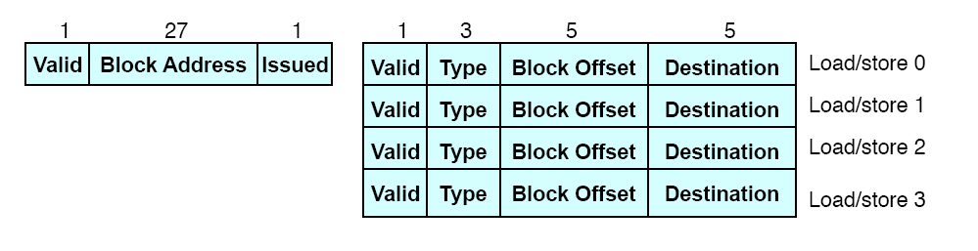
Miss Status Handling Register Entry

Slide 33
MSHR Operation
On a cache miss:
Search MSHRs for a pending access to the same block
Found: Allocate a load/store entry in the same MSHR entry
Not found: Allocate a new MSHR
No free entry: stall
When a subblock returns from the next level in memory
Check which loads/stores waiting for it
Forward data to the load/store unit
Deallocate load/store entry in the MSHR entry
Write subblock in cache or MSHR
If last subblock, dellaocate MSHR (after writing the block in cache)

Slide 34
Non-Blocking Cache Implementation
When to access the MSHRs?
In parallel with the cache?
After cache access is complete?
MSHRs need not be on the critical path of hit requests
Which one below is the common case?
Cache miss, MSHR hit
Cache hit

Slide 35
Enabling High Bandwidth Memories

Slide 36
Multiple Instructions per Cycle
Can generate multiple cache/memory accesses per cycle
How do we ensure the cache/memory can handle multiple accesses in the same clock cycle?
Solutions:
true multi-porting
virtual multi-porting (time sharing a port)
multiple cache copies
banking (interleaving)

Slide 37
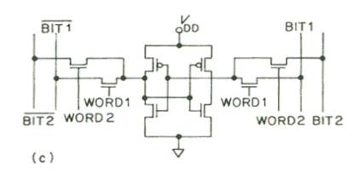
Handling Multiple Accesses per Cycle (I)
True multiporting
Each memory cell has multiple read or write ports
+ Truly concurrent accesses (no conflicts on read accesses)
-- Expensive in terms of latency, power, area
What about read and write to the same location at the same time?
Peripheral logic needs to handle this

Slide 38
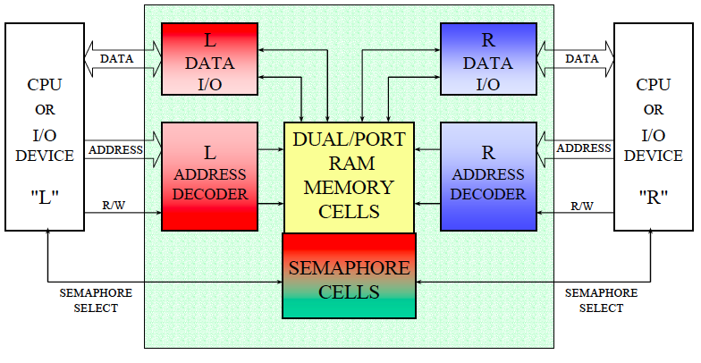
Peripheral Logic for True Multiporting

Slide 39
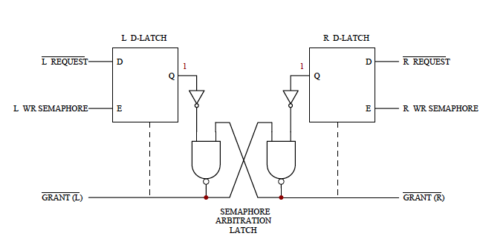
Peripheral Logic for True Multiporting

Slide 40
Handling Multiple Accesses per Cycle (II)
Virtual multiporting
Time-share a single port
Each access needs to be (significantly) shorter than clock cycle
Used in Alpha 21264
Is this scalable?

Slide 41
Handling Multiple Accesses per Cycle (III)
Multiple cache copies
Stores update both caches
Loads proceed in parallel
Used in Alpha 21164
Scalability?
Store operations form a bottleneck
Area proportional to “ports”
Port 1
Load
Cache
Copy 1
Port 1
Data
Store
Cache
Copy 2
Port 2
Data
Port 2
Load

Slide 42
Handling Multiple Accesses per Cycle (III)
Banking (Interleaving)
Bits in address determines which bank an address maps to
Address space partitioned into separate banks
Which bits to use for “bank address”?
+ No increase in data store area
-- Cannot satisfy multiple accesses
to the same bank
-- Crossbar interconnect in input/output
Bank conflicts
Two accesses are to the same bank
How can these be reduced?
Hardware? Software?
Bank 0:
Even
addresses
Bank 1:
Odd
addresses

Slide 43
General Principle: Interleaving
Interleaving (banking)
Problem: a single monolithic memory array takes long to access and does not enable multiple accesses in parallel
Goal: Reduce the latency of memory array access and enable multiple accesses in parallel
Idea: Divide the array into multiple banks that can be accessed independently (in the same cycle or in consecutive cycles)
Each bank is smaller than the entire memory storage
Accesses to different banks can be overlapped
A Key Issue: How do you map data to different banks? (i.e., how do you interleave data across banks?)

Slide 44
Further Readings on Caching and MLP
Required: Qureshi et al., “A Case for MLP-Aware Cache Replacement,” ISCA 2006.
Glew, “MLP Yes! ILP No!,” ASPLOS Wild and Crazy Ideas Session, 1998.
Mutlu et al., “Runahead Execution: An Effective Alternative to Large Instruction Windows,” IEEE Micro 2003.

Slide 45
Multi-Core Issues in Caching

Slide 46
Caches in Multi-Core Systems
Cache efficiency becomes even more important in a multi-core/multi-threaded system
Memory bandwidth is at premium
Cache space is a limited resource
How do we design the caches in a multi-core system?
Many decisions
Shared vs. private caches
How to maximize performance of the entire system?
How to provide QoS to different threads in a shared cache?
Should cache management algorithms be aware of threads?
How should space be allocated to threads in a shared cache?

Slide 47
Private vs. Shared Caches
Private cache: Cache belongs to one core (a shared block can be in multiple caches)
Shared cache: Cache is shared by multiple cores
CORE 0
CORE 1
CORE 2
CORE 3
CORE 0
CORE 1
CORE 2
CORE 3
L2
CACHE
L2
CACHE
L2
CACHE
L2
CACHE
L2
CACHE
DRAM MEMORY CONTROLLER
DRAM MEMORY CONTROLLER

Slide 48
Resource Sharing Concept and Advantages
Idea: Instead of dedicating a hardware resource to a hardware context, allow multiple contexts to use it
Example resources: functional units, pipeline, caches, buses, memory
Why?
+ Resource sharing improves utilization/efficiency → throughput
When a resource is left idle by one thread, another thread can use it; no need to replicate shared data
+ Reduces communication latency
For example, shared data kept in the same cache in multithreaded processors
+ Compatible with the shared memory model

Slide 49
Resource Sharing Disadvantages
Resource sharing results in contention for resources
When the resource is not idle, another thread cannot use it
If space is occupied by one thread, another thread needs to re-occupy it
- Sometimes reduces each or some thread’s performance
- Thread performance can be worse than when it is run alone
- Eliminates performance isolation → inconsistent performance across runs
- Thread performance depends on co-executing threads
- Uncontrolled (free-for-all) sharing degrades QoS
- Causes unfairness, starvation
Need to efficiently and fairly utilize shared resources

Slide 50
Private vs. Shared Caches
Private cache: Cache belongs to one core (a shared block can be in multiple caches)
Shared cache: Cache is shared by multiple cores
CORE 0
CORE 1
CORE 2
CORE 3
CORE 0
CORE 1
CORE 2
CORE 3
L2
CACHE
L2
CACHE
L2
CACHE
L2
CACHE
L2
CACHE
DRAM MEMORY CONTROLLER
DRAM MEMORY CONTROLLER

Slide 51
Shared Caches Between Cores
Advantages:
High effective capacity
Dynamic partitioning of available cache space
No fragmentation due to static partitioning
Easier to maintain coherence (a cache block is in a single location)
Shared data and locks do not ping pong between caches
Disadvantages
Slower access
Cores incur conflict misses due to other cores’ accesses
Misses due to inter-core interference
Some cores can destroy the hit rate of other cores
Guaranteeing a minimum level of service (or fairness) to each core is harder (how much space, how much bandwidth?)

Slide 52
Shared Caches: How to Share?
Free-for-all sharing
Placement/replacement policies are the same as a single core system (usually LRU or pseudo-LRU)
Not thread/application aware
An incoming block evicts a block regardless of which threads the blocks belong to
Problems
Inefficient utilization of cache: LRU is not the best policy
A cache-unfriendly application can destroy the performance of a cache friendly application
Not all applications benefit equally from the same amount of cache: free-for-all might prioritize those that do not benefit
Reduced performance, reduced fairness

Slide 53
Example: Utility Based Shared Cache Partitioning
Goal: Maximize system throughput
Observation: Not all threads/applications benefit equally from caching → simple LRU replacement not good for system throughput
Idea: Allocate more cache space to applications that obtain the most benefit from more space
The high-level idea can be applied to other shared resources as well.
Qureshi and Patt, “Utility-Based Cache Partitioning: A Low-Overhead, High-Performance, Runtime Mechanism to Partition Shared Caches,” MICRO 2006.
Suh et al., “A New Memory Monitoring Scheme for Memory-Aware Scheduling and Partitioning,” HPCA 2002.

Slide 54
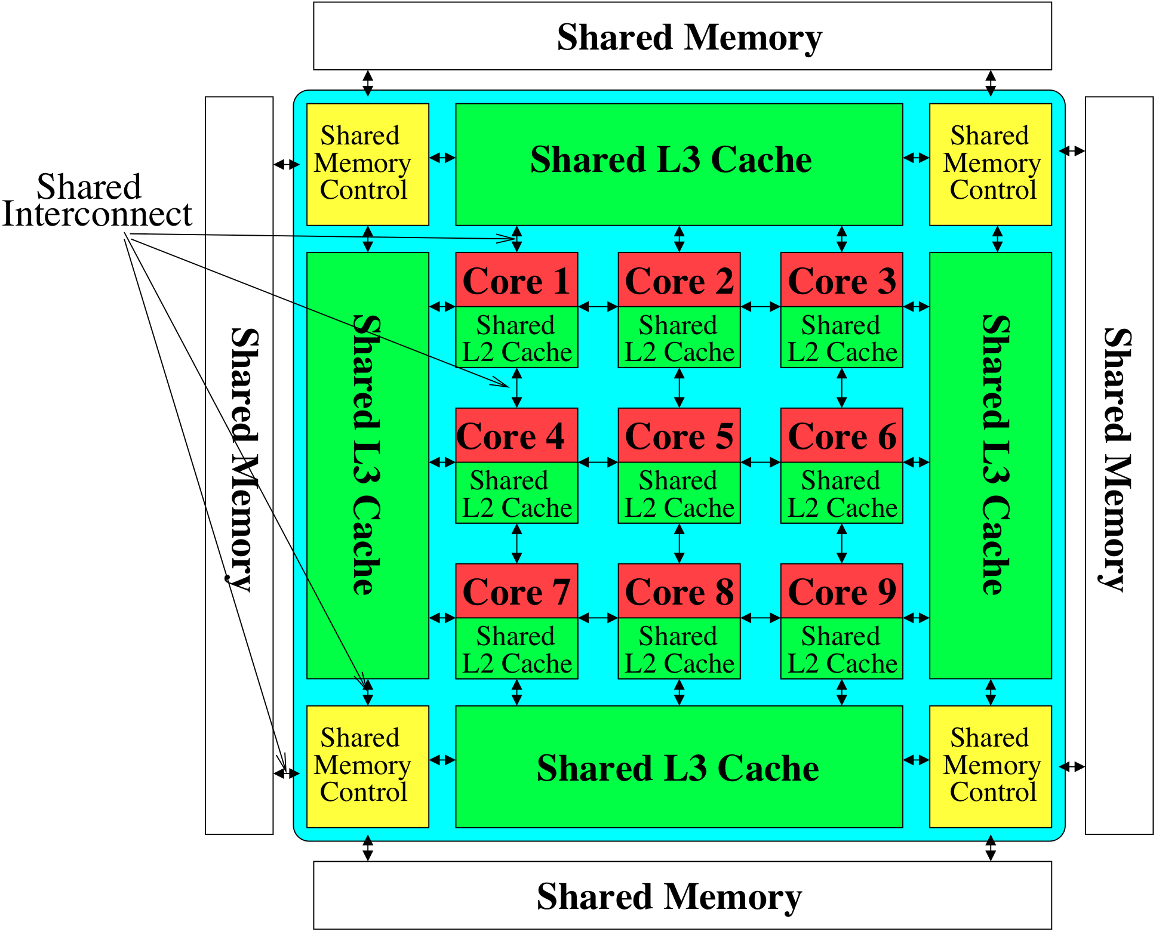
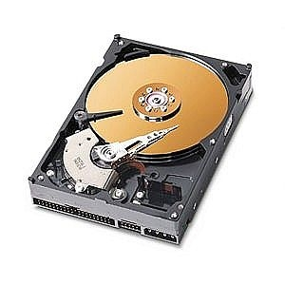
The Multi-Core System: A Shared Resource View
Shared
Storage

Slide 55
Need for QoS and Shared Resource Mgmt.
Why is unpredictable performance (or lack of QoS) bad?
Makes programmer’s life difficult
An optimized program can get low performance (and performance varies widely depending on co-runners)
Causes discomfort to user
An important program can starve
Examples from shared software resources
Makes system management difficult
How do we enforce a Service Level Agreement when hardware resources are sharing is uncontrollable?

Slide 56
Resource Sharing vs. Partitioning
Sharing improves throughput
Better utilization of space
Partitioning provides performance isolation (predictable performance)
Dedicated space
Can we get the benefits of both?
Idea: Design shared resources such that they are efficiently utilized, controllable and partitionable
No wasted resource + QoS mechanisms for threads

Slide 57
Shared Hardware Resources
Memory subsystem (in both multithreaded and multi-core systems)
Non-private caches
Interconnects
Memory controllers, buses, banks
I/O subsystem (in both multithreaded and multi-core systems)
I/O, DMA controllers
Ethernet controllers
Processor (in multithreaded systems)
Pipeline resources
L1 caches

